Slide 1

Prediction of Air Quality Index using Machine Learning and Deep Learning Techniques
Presented by
Poornima Ravindra
10535945

Slide 2
ABSTRACT
Over the past few decades air emissions and its mitigation are the fundamental challenges faced by the world. The mortality rate is increased as the air pollution has adversely affected respiratory and cardiovascular system. Lots of efforts has been taken by the government to predict air quality levels which aims at improving public health. This research scientifically contributes to the air pollution challenges so that preventive measures can be taken by the people. Since this dataset doesn’t have any label so K-means Cluster is used to find the class for this dataset. Artificial Neural Network and other four Machine Learning techniques are used for classification and it is compared to check which gives more accuracy in predicting the Air Quality Index. Auto Regression is used to find next three months air quality.

Slide 3
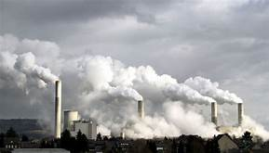
Introduction
Air pollution can cause fatal diseases to human beings, damage to other living things and environment.
Air pollution in India is a major concern so identifying and predicting the air quality will surely help in making decisions and will contribute in protecting the safety of residents.

Slide 4
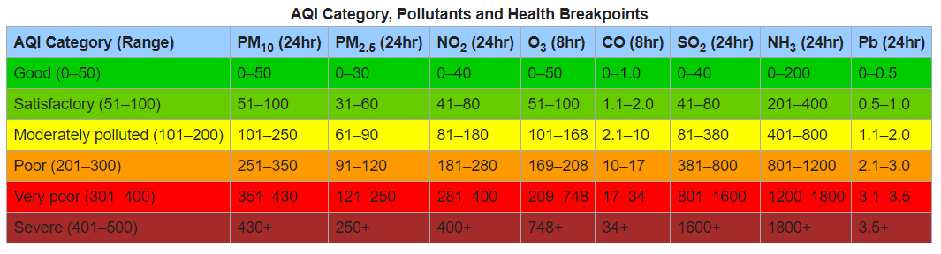
Air Quality Index
An air quality index ( AQI) is used by government agencies to communicate to the public how polluted the air currently is or how polluted it is forecast to become. Public health risks increase as the AQI rises. Different countries have their own air quality indices, corresponding to different national air quality standards.

Slide 5
Research Questions
Which algorithms will work better in classification; Traditional or Deep Learning algorithms?
How will Air Quality Index prediction help people?
How can we apply this work in real-time?

Slide 6
Objective
To build a model that can predict Air Quality Index
Compare the accuracy using different Machine Learning Techniques

Slide 7
Literature Review
Predicting air quality using multiple techniques has been proposed and implemented by many researchers. These approaches comprise all conventional methods as well as modern machine learning and deep learning algorithms. So, the discussion here will be about different types of algorithms developed and implemented to predict and identify the air quality by the researchers over a period of time.

Slide 8
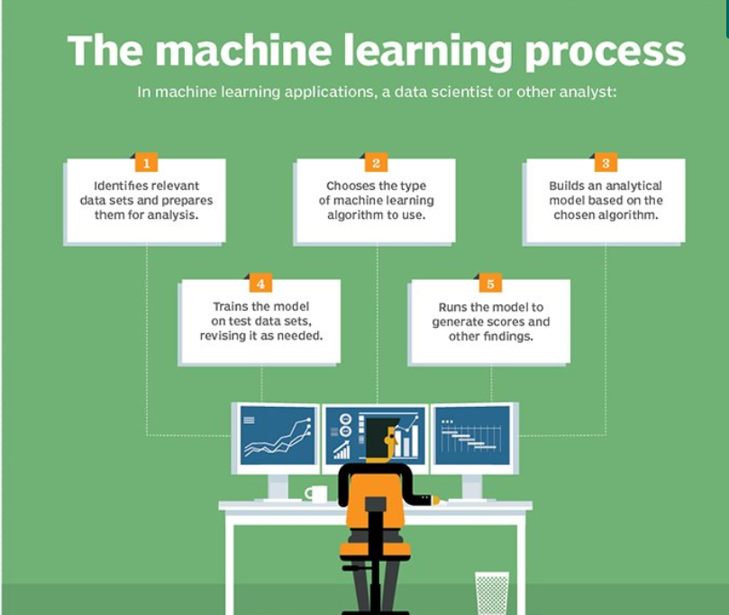
Machine Learning Process

Slide 9
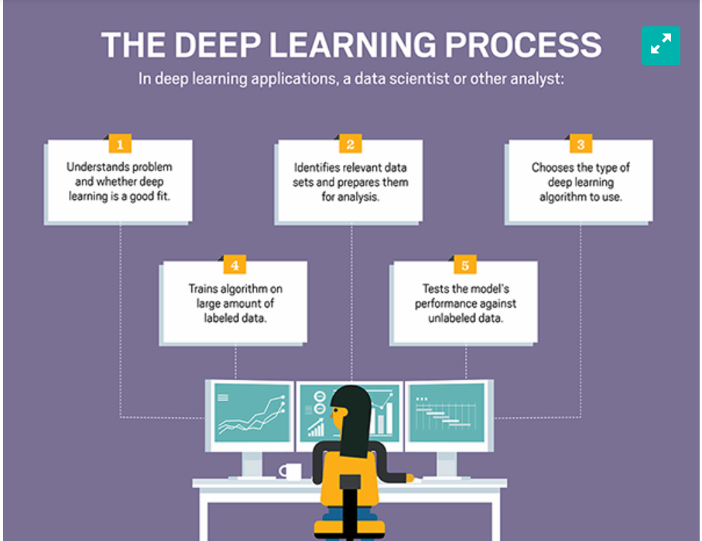
Deep Learning Process

Slide 10
Dataset
The dataset contains air quality data from various stations across multiple cities in India from 2015 to 2020.
The concentration levels of 12 gases has been recorded and has been made publicly available by the Central Pollution Control Board. The dataset contains 14705 records.

Slide 11
Software Used
Python
Python is a very powerful high-level and structured language with simple syntax and flexible semantics.
Pandas
This module is used for data analysis. It should be manually installed as it is not bundled with Python.
Keras
Keras is a Python library built on top of the TensorFlow framework. It is flexible and convenient to learn.

Slide 12
Machine Learning models used to Predict Air Quality
Artificial Neural Network
Support Vector Classification
Random Forest Classification
Logistic Regression
Naïve Bayes

Slide 13
Evaluation
Confusion Matrix
Accuracy
Precision
Recall

Slide 14
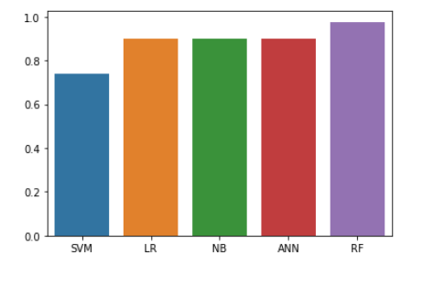
Accuracy Comparison
The accuracy of Artificial Neural Network is compared with four Machine Learning Algorithms.

Slide 15
Auto Regression is used to find next three months air quality.
The model is designed in such a way that the air quality can be found for any of the cities present in the dataset. Based on average value the air quality is classified into Good, Satisfactory, Moderate, Poor and Severe.

Slide 16
Conclusion
Air pollution is a major concern so identifying and predicting the air quality will surely help in making decisions and will contribute in protecting the safety of residents. Human activities can be scheduled in a defined geographical area using air quality predictors and it also helps in reducing the adverse impact of emissions.
Machine Learning and Deep Learning models were constructed for predicting the air quality in different cities of India using five years database. The model is designed in such a way that the air quality can be found for any of the cities present in the dataset. Based on average value the air quality is classified into Good, Satisfactory, Moderate, Poor and Severe.

Slide 17
Future Enhancement
This model can be interfaced with the user's web application which can benefit from the work and take precautions to maintain minimal air pollution levels.
Only five algorithms are tested and evaluated, lot of other tools and techniques can be applied on this data. It will help bridge the gap that existed in this model.

Slide 18
References
Afzali, M. A. A. a. Z. G., 2012. The Potential of Artificial Neural Network Technique in Daily andMonthly Ambient Air Temperature Prediction.. International Journal of Environmental Scienceand Development., pp. 33-38.
Anon., 2013. Identifying pollution sources and predicting urban air quality using ensemble learning methods. Atmospheric environment, pp. 426-437.
Azid, A. J. H. L. T. Z. M. a. O., 2013. Feed-Forward Artificial Neural NetworkModel for Air Pollutant Index Prediction in theSouthern Region of Peninsular Malaysia. EnergyJournal of Environmental Protection., pp. 1-10.
Barbes, L. N. C. M. L. I. V., 2009. The Use of Artificial Neural Network (ANN) forPrediction of Some Airborne PollutantsConcentration in Urban Areas. Journal of Rev.Chem, pp. 301-307.

Slide 19

Thank you

